Slide 1


Streaming Architecture
Instructor：Prof. Pedram
Mentor: Arash, Amirhossein
Present by: Ryan

Slide 2


Things I have done
My Current Work
Problems I meet
CONTENTS
Next Step

Slide 3

Things I have done
Streaming Arch
1. Use FINN code to implement one-layer of convolution on SDx
2. Print out hardware resources usage info
3. The SW simulation is pass for Two layers implementation
Nulla-net Verilog
1. Help Jeffery wrote the first version of Verilog Script

Slide 4
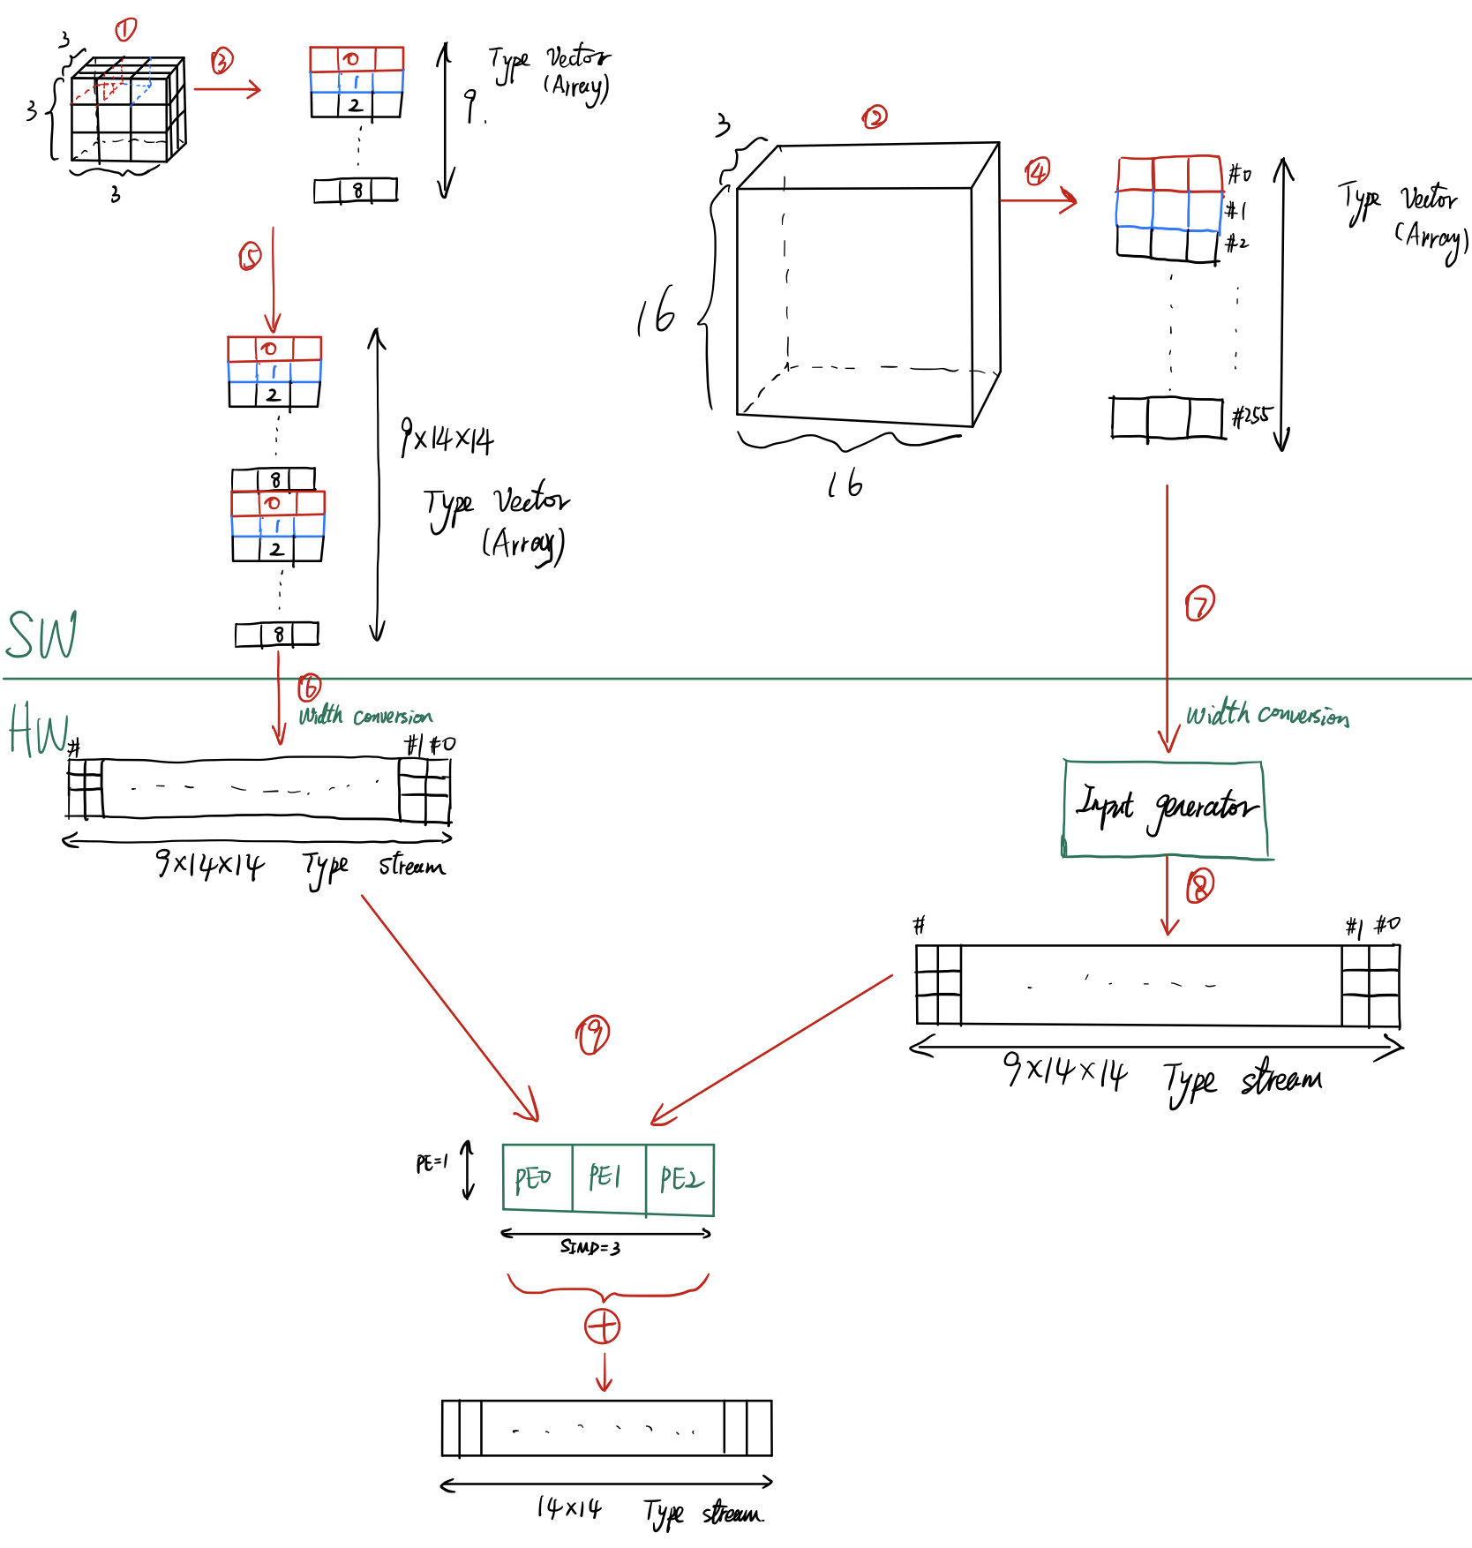
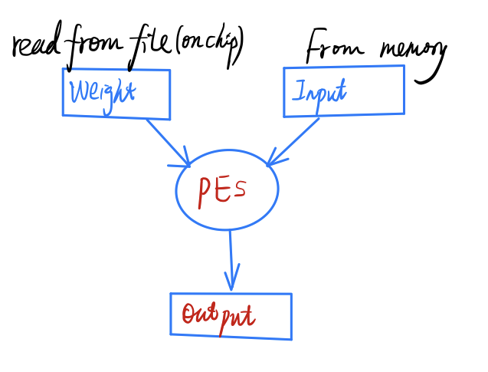
Things I have done
With FINN design

Slide 5
Things I have done
With FINN design
3x3x4
16x16x4
1x4

Slide 6
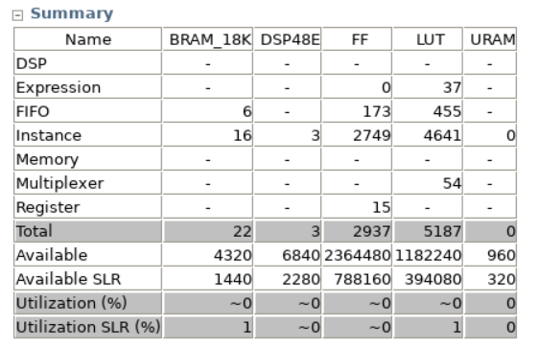
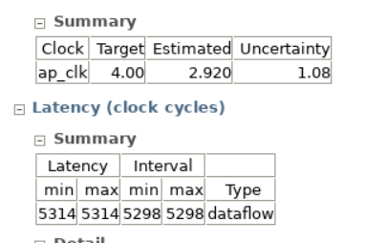
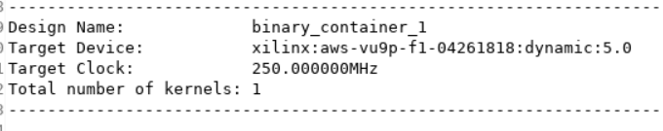
Things I have done
With FINN design one-layer

Slide 7
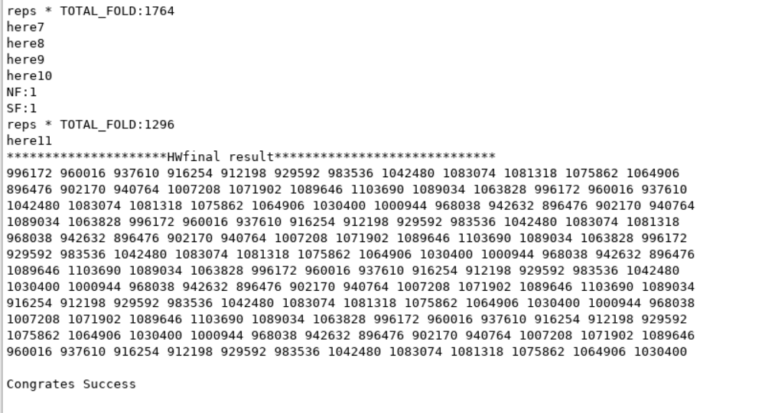
Things I have done
With FINN design Two-layer

Slide 8
Things I have done
For Nulla Script
One-layer is done
multi-layer Verilog
provide any help that Jeffery need

Slide 9
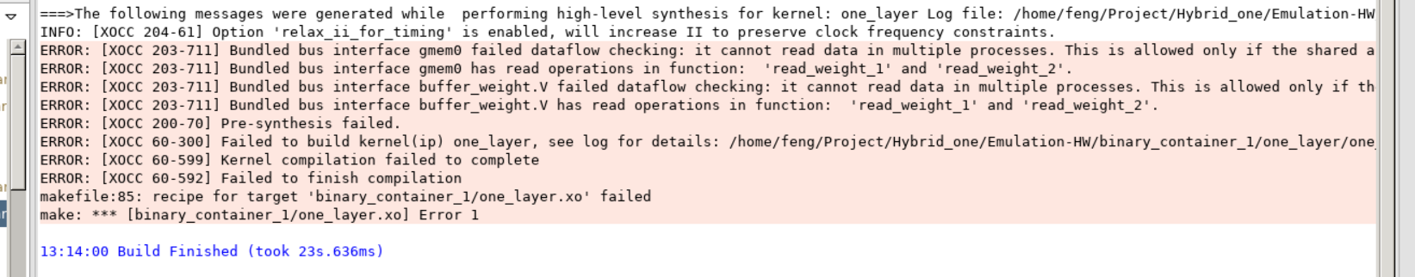
My Current Work
With FINN design
Working with two-layer HW simulation.
Try to get hardware resources usage info

Slide 10
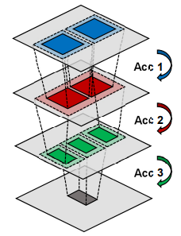
Problems I meet
#1
The current design only support one filter
#2
The current design can only pack one pixel into one element. And when transferring data from host to hardware, it must be a power of two.

Slide 11
Next Step
#1
Solve previous problems, and try to make my design can be used in VGG16
#2
Provide any help for Jeffery’s Verilog Script

Slide 12


